Slide 1
Nutrition Labeling
Lesson 3
Notes:
Does anyone know what a nutrition label is?

Slide 2
WHY should you read nutrition labels???
They tell you how healthy a food is.
Do you have allergies?
Nutrition Needs
Where does it come from?
Notes:
Allergies: You can read the label to see if you are allergic to anything in the product.
Nutrition Needs: —For example, if you have diabetes, you need to know about the sugars in the product.
Where? -- the USA or somewhere else?

Slide 3
WHY choose healthier foods?

Slide 4


You will do better in school.
Remember, your choices about what you eat and drink affect your ability to think clearly

Slide 5

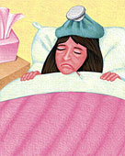


You won’t get sick as often and will not feel as stressed.

Slide 6
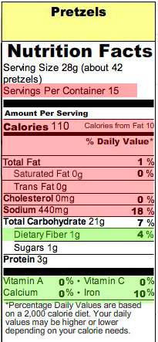

Looking at the Facts
Look at the number of servings in the package.
The label only shows the amounts for ONE serving!
www.ChefSolus.com
Copyright © Nourish Interactive, All Rights Reserved

Slide 7
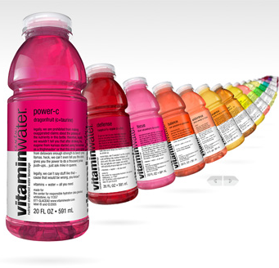
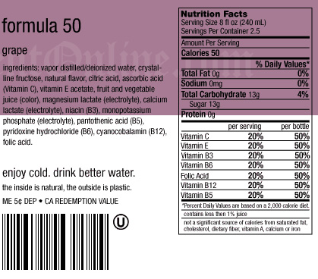
VITAMIN WATER
Watch out for tricky labels! Look at the number of servings per container.
http://www.crossfitvalleypark.com/.a/6a00e54ef843e38833011168416dc2970c-800wi

Slide 8
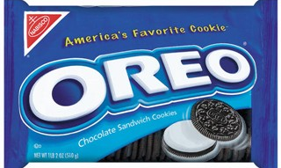
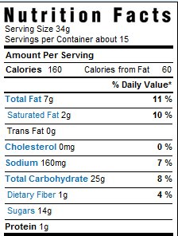
A Pack of Oreos
http://willrunforcake.files.wordpress.com/2009/06/oreos_1.jpg
Sometimes they don’t tell you how many cookies are in one serving. 34g equals only 3 cookies!
http://www.healthylessons.com/wp-content/uploads/2009/05/oreo_short_nutrition_label1.jpg
http://www.fitnessmantra.info/fitness/wp-content/uploads/2006/08/100_calorie_pack__oreo.gif

Slide 9
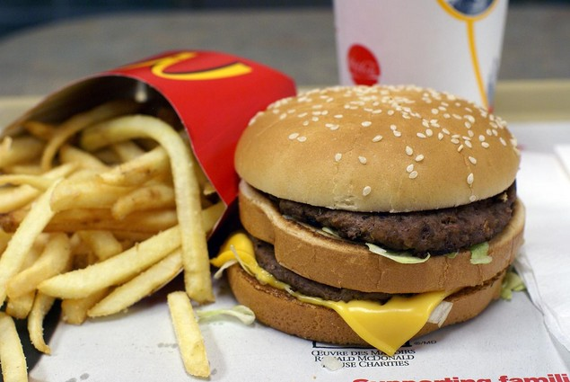
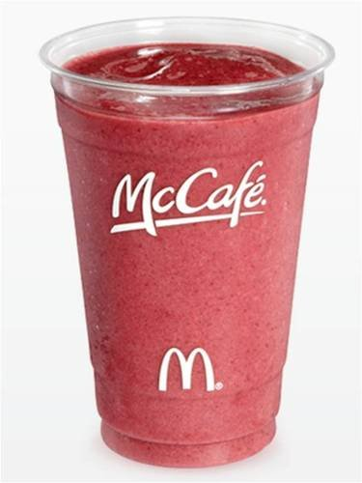
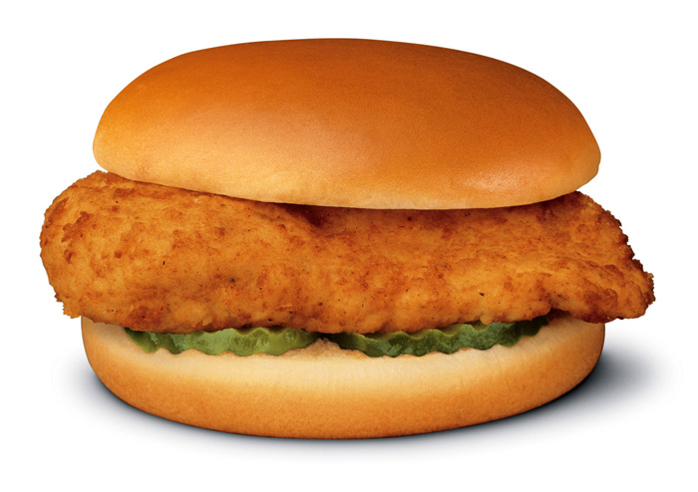
 | Big Mac | Large French Fries
Total Fat: | 29g | 25g
 | Chicken Sandwich | Smoothie
Total Fat: | 20g | 1g

Slide 10
Which one would you choose???

Slide 11
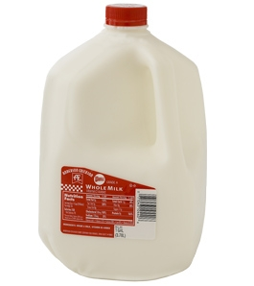
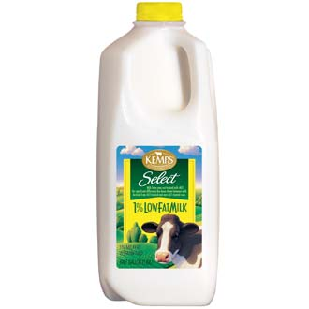
Whole fat milk OR 1% low-fat milk?
Whole Milk
1% Milk
Product | Calories | Fat (g) | Alternative | Calories | Fat (g)
1 cup Whole Fat Milk | 150 | 8 | 1% Low Fat Milk | 100 | 3
Notes:
Be sure to look at the serving sizes!

Slide 12
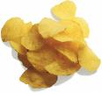

A bag of potato chips OR pretzels???
Potato Chips
Pretzels
Product | Calories | Fat (g) | Alternative | Calories | Fat (g)
Bag of Potato Chips (1 oz) | 165 | 12 | Pretzels | 110 | 0
Notes:
How many of you only eat 1 oz of chips?!

Slide 13
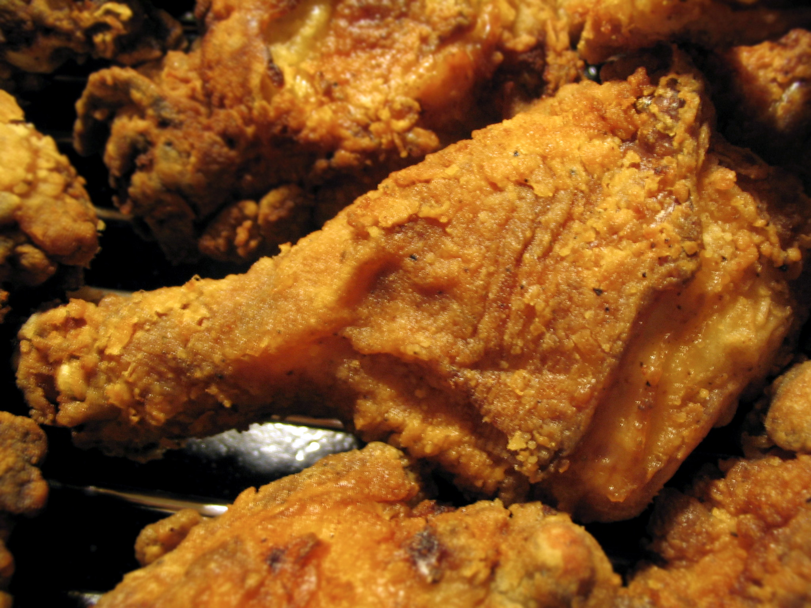
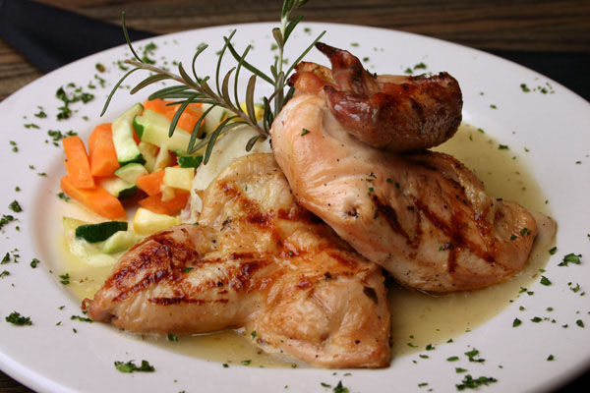
Fried or baked chicken???
Fried Chicken
Baked or Grilled Chicken
Product | Calories | Fat (g) | Alternative | Calories | Fat (g)
Fried Chicken (4 oz) | 330 | 19 | Skinless Baked Chicken | 217 | 8

Slide 14
Sugar
The average American consumes 146 lbs of sugar each year!
USDA recommends no more than 10 teaspoons of sugar/day.
4 grams of sugar = 1 teaspoon (tsp)
Notes:
VISUAL REP. of TSP. and bag of that amt. of sugar in hand.
Baggie for coke and baggie for milkshake and visual of can/cup

Slide 15
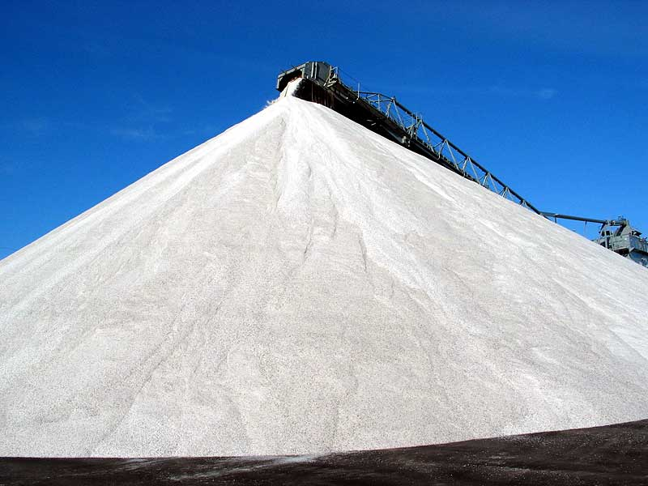
Salt
The average American consumes…
4000 to 5000 mg of salt per day! But nutritionists recommend between 1200 to 1500 mg/day.
High salt increases risk of:
High blood pressure
Heart disease
The number of mg of salt should not be more than the number of calories! Milligrams of salt ≤ calories
(for example, if you have a food product that has 400 calories, it should have less than 400 milligrams of salt.)
Notes:
For example, 100mg sodium : 100 calories

Slide 16
How many grams in a tsp of sugar? If a box of cookies has 3 servings, and each serving contains 10 grams of sugar, how much sugar is there in the entire box? Is salt part of a food group? Nutrient Group? If so, which one? Why don’t we want too much salt in our diet?
Review!

Slide 17

Now it’s YOUR turn to do your own detective work!
GOOD LUCK!

